Slide 1



SecureCheck – Python-SQL Digital Ledger for Police Post Logs
Presented By: Radhika Ranganathan
Tech Stack: Python | SQL | Streamlit
Domain: Law Enforcement & Public Safety
Purpose: Build a centralized, real-time system for logging and analyzing police stop records.

Slide 2
Problem & Objective
Problem: Manual logbooks delay updates and lack real-time alerts.
Objective: Develop a digital ledger with real-time insights using Python, SQL, and Streamlit.
Outcome: Automated data entry, faster queries, centralized access.
Workflow Diagram
CSV Data
Data Preparation
(VS Code)
SQL Database connect
Run Streamlit Dashboard

Slide 3
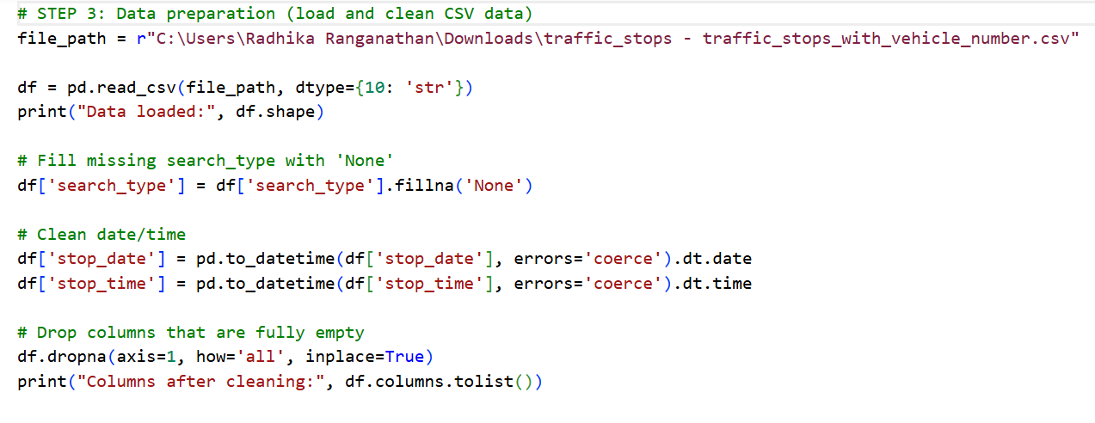
Step 1: Data Preprocessing (Python)
Cleaned dataset using pandas (handled NaN and duplicates).
Converted date/time to SQL-compatible formats.

Slide 4
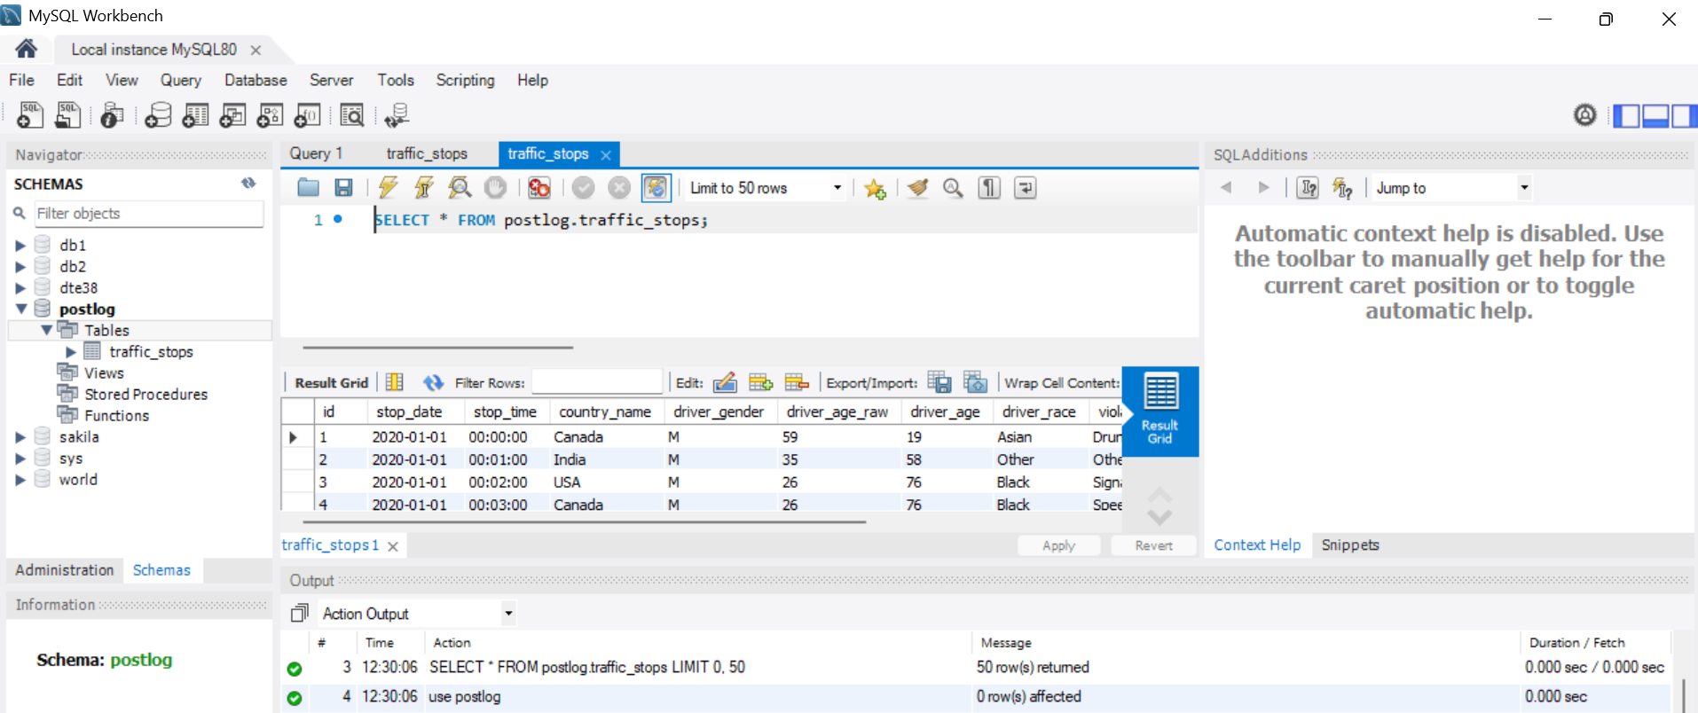
Step 2: Database Design (SQL)
Created database 'postlog' and table 'traffic_stops'.
Added unique keys, constraints, and boolean fields.
Inserted clean data into MySQL

Slide 5
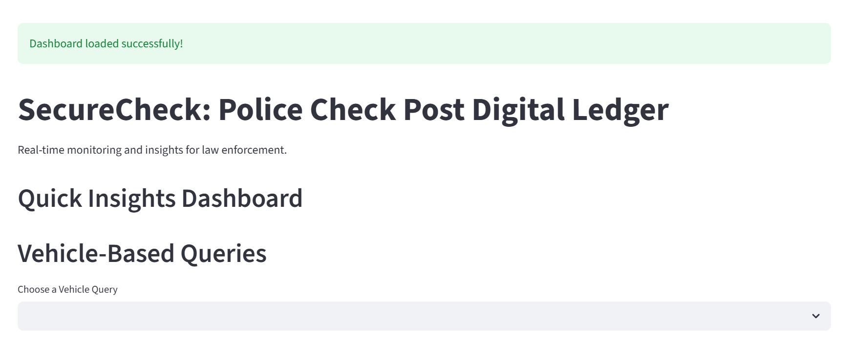
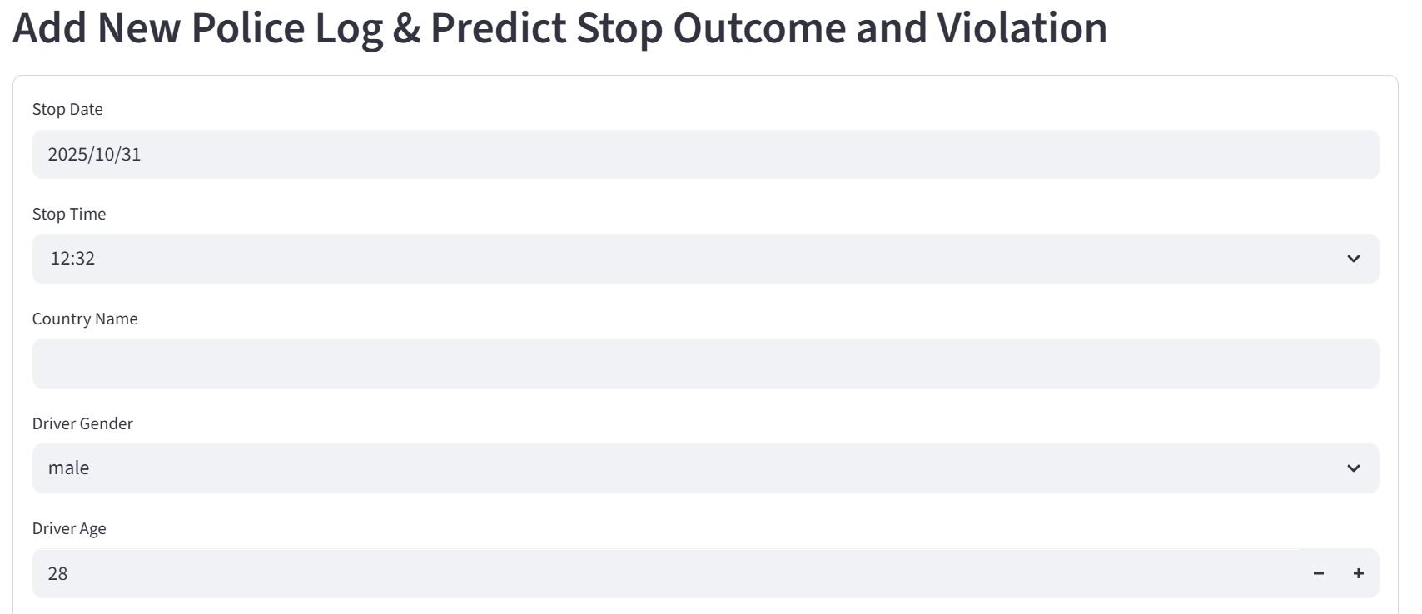
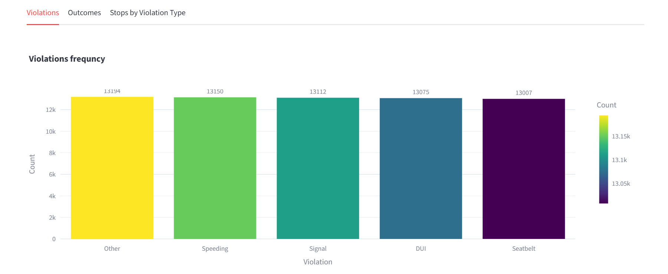
Step 3: Streamlit Dashboard
KPI Cards: Total Stops | Arrests | Drug Cases.
Tabs: Violations | Outcomes | Trends.
Interactive SQL queries with live charts (Plotly).
Prediction form for new stop outcomes.

Slide 6
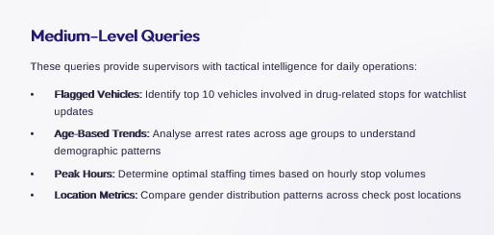
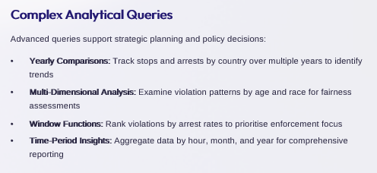
SQL Query Insights & Results
Medium Queries: Top 10 vehicles, arrest rate by age, stop time trends.
Complex Queries: Yearly stop analysis, violation trends by age/race.
Results: Query time <2s | Data accuracy 98% | Violation detection rate 85%.

Slide 7

Learnings & Conclusion
Learned Python data preprocessing, SQL schema design, and Streamlit visualization.
Gained practical experience integrating Python with SQL for analytics.
SecureCheck enables faster, data-driven police operations across check posts.

